Slide 1

ANTI-CD47 THERAPY:
A NOVEL TREATMENT FOR RHEUMATOID ARTHRITIS
Logan Beharry
Notes:
Hello, My name is Logan Beharry and the title of my project is Anti-CD47 Therapy a novel treatment for Rhuematoid Arthritis

Slide 2
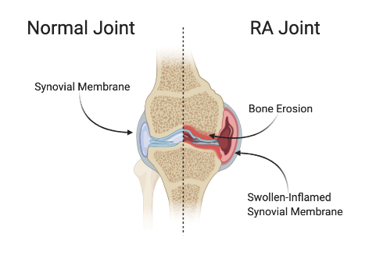
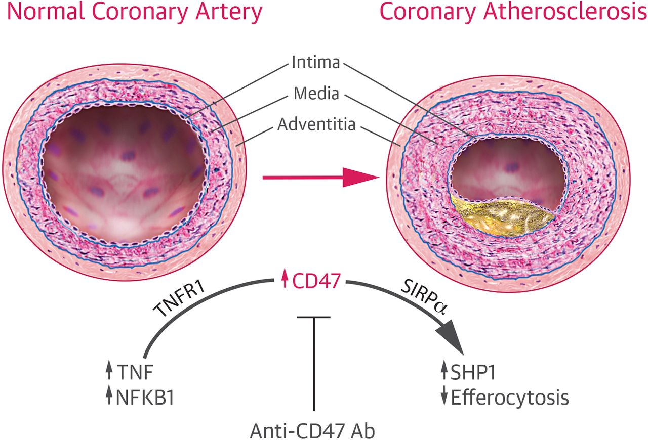
Introduction
Image 1: Student Created
Image 2 Source: “CD47-Blocking Antibodies and Atherosclerosis.”Researchgate, John Ryan.
Notes:
Rheumatoid Arthritis (RA) is a chronic inflammatory disorder that affects greater than 2 million Americans. RA causes fatigue, pain and swelling and places patients at a greater risk for developing other inflammatory disorders. In RA, the body’s immune system is unable to resolve inflammation in the synovium, or the membrane that lines the joints. This causes a buildup fluids, commonly referred to as swelling.
Image 1 depicts the difference between a healthy joint and arthritic one. The overexspression of the pro-inflammatory cytokines Tumor Necrosis Factor and Interlukin 6 are used to identify Rhuemoatid Arthirits, which results when diseased synovioyctes producing Tumer Necrosis Alpha are unable to be engulfed by macrophages. The reasoning behind this, however, remains unclear
The invovlement of TNF Alpha and inhibition of phayctosis does enulate the dfeatures iabothe rinflammatiory diusease, astheroclerosis.
Recently, Stanford University School of Medicine discovered that CD47 inhibits the engulfment of diseased plaque cells in atherosclerosis. CD47 a ubiquitous glycoprotein, that inhibits phagocytosis by binding to the SIRP𝛼 receptor on macrophages. Using CD47 knockout technicques, researchers increased engulfment of artieral plaqques.
The connection between these two diseases drove the following hypothesis.

Slide 3
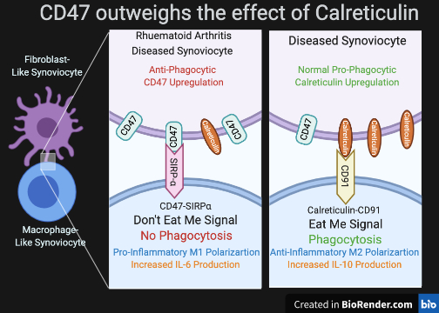
Objective / Hypothesis
It was hypothesized that synovial-inflammation in RA is mediated by CD47 overexpression. This explains the mechanism that inhibits engulfment of diseased Synoviocytes and leads to unresolved inflammation . Thus, If an Anti-CD47 antibody is used to reduce CD47 expression, Macrophage-Like Synoviocytes will be able to successfully engulf them, preventing the extreme inflammation associated with RA.
The objective of this project is to elucidate the role of CD47 in Rheumatoid Arthritis and asses the effects of neutralizing the protein via monoclonal antibody
Image 3: Student Created
Notes:
The image to the left denotes the how cells regulage phagocytrosis, through phagocytic proteins. CD47 is a do not eat me singal and is counterbalanced by Calrerituciln an Eat Me signal. When CD47 is overexspressed on cells, however, it dramatically outweighs the effect of calreticulin and inhibits phjagocytosis. THerefore, high levels of calreticulin are indicative of phagocysis.

Slide 4
Materials, Equipment, Facilities
General Materials List:
Basic Cell Culture Reagents and Materials
  T-25 Flasks, Pipettes, Fetal Bovine Serum , 0.25% Trypsin EDTA, DMEM Dulbecco's Modified Eagle Media
Fibroblast Like-Synoviocyte Cell Line (SW982)
Macrophage Like-Synoviocyte Cell Line (RAW264.7)
Indirect ELISA Kit
Monoclonal B6H12 Anti-CD47 Antibody
Tumor-Necrosis Factor Alpha- Recombinant Human Protein
PKH67 & PKH26 Red & Green Fluorescent Cell Linker Kits
Essential Equipment:
Basic Cell Culture Equipment
  Incubator, Biological Safety Cabinet, Inverted Microscope, Centrifuge, ViCell Cell Counter
Inverted Microscope and with Imaging and Fluorescence Capabilities
Spectrophotometer with Fluorescence Capabilities
Facilities:
All research was conducted in the Cell-Biology Lab at Bergen County Academies, Hackensack.
Notes:
Listed here are the most important materials and equipment used that will be explained in detail upon explamatipm pf the procedure as well as the Data & Results. In terms of facilities, all research and labwork was conduxted at the Cell Biology Lab at Bergen County Acadmies Hackensack

Slide 5
Procedure
Optimize the RA Model
SW982 Cells will be plated and treated with varying concentrations of TNF-Alpha to ensure it induces arthritic behavior. An MTS Assay will be used to measure viability; Increasing concentrations of TNF-Alpha should reduce cell viability.
Establish presence and possible overexpression of CD47 in RA
In Arthritic SW982 cells, levels of CD47 will be measured via indirect enzyme linked immunosorbent assay (ELISA). Using a CD47 specific antibody, CD47 levels will be measured in plated cells. This will determine the presence of the protein. Increasing concentrations of TNF-Alpha will be used to determine if arthritic behaviour affects the production of CD47.
Understand Phagocytic Relationship between MLS & FLS and CD47’s involvement
To understand phagocytosis in the synovium, FLS-SW982 and MLS-Raw264.7 cocultures will be created. One group as control will receive no treatment, another group will have SW982 cells treated with TNF-Alpha before coculture, and the final group will receive both TNF-Alpha & Anti-CD47 Antibody treatment. This will permit the assessment of the RA synovium and the RA synovium with Anti-CD47 treatment. Cells will be fluorescently stained and overall fluorescence will be measured, as well as calreticulin and IL-6
Notes:
The first step of this project was to
The second step is to
The final step is

Slide 6
Data & Graphs:
MTS ASSAY
Figure 4 The Effect of TNF𝛼 on SW982 Viability:
SW982 Cells were plated in a 96-well plate and treated with varying concentrations of TNF𝛼 for 24 hours. After 24 hours, viability was measured. All concentrations significantly reduced viability. The most effective concentration was found to be 100ng/ml. Bars represent standard deviations (+/-). Data marked with asterisk were significantly different than values from the control group: P<0.05*, P<0.01**, P<0.001***
Notes:
As mentioned before, Plated Synoviocyte cells were treated with concentrations of TNF Alpha. The MTS assay uses spectroscopy to measure cell viability. As expected increasing concn reduced cell viability effectively modeling RA. The 100 ng / ml concentratins was deemed the most effective and would be used for later experiments. Also, it is used more frequently than the 50 ng /ml concnetration in scientific literature.

Slide 7
Figure 6 Images of Macrophages Post-Coculture:
PHAGOCYTIC ASSAY
Figure 6:
(A) Fluorescence Microscopy Image of Stained Raw264.7 macrophages. These macrophages were not cocultured or treated. (B) Image of coculture stimulated with TNF𝛼 +Anti-CD47. This image shows greater regions of double-stained cells indicative of successful phagocytosis. (C) This image demonstrates that TNF𝛼 stimulation impairs successful phagocytosis. (D) This image shows stained Synoviocytes that were not treated or cocultured. (E) This image is of macrophages that were in the TNF𝛼 +Anti-CD47 coculture filtered to show the incidence of red that was carried over by the macrophages. (F) This image is of macrophages from the TNF𝛼 coculture. The red fluorescence carried over by these macrophages is low.
A
B
C
D
E
F
Notes:
Figure 6 displayes Images of Macrophages post Coculture: Macrophages Raw264.7 and Sw982 Synoviocytes were cocultured in order to determine if neutralizing CD47 would impact phagocytosis in the model of RA. Synoviocytes were stained red, and Macrophages were stained green. After coculture, macrophages were seperated and images. The greater the incidence of successful phagocytosis should result in a greater amount of double-stained cells due to the engulfment of the cell membrane by macrophages.
To the far left is images of the intially stained cells pre coculture. The center is images of macrophages from the Anti CD47 and TNF group and the far right is the group treated with TNF only. Imges E and F are the same as B and C, but is filtered to show the Red flourescne. This represents phagocytic activity
(A) Fluorescence Microscopy Image of Stained Raw264.7 macrophages. These macrophages were not cocultured or treated. (B) Image of coculture stimulated with TNF𝛼 +Anti-CD47. This image shows greater regions of double-stained cells indicative of successful phagocytosis. (C) This image demonstrates that TNF𝛼 stimulation impairs successful phagocytosis. (D) This image shows stained Synoviocytes that were not treated or cocultured. Essentially, E & F are the same images as B & C, however they are filtered to show just the incidience of RED flourscnse. This demonstrsates that there was a lower phagocytic index in the TNF Alpha only cocuoture
Laslty, images B & C clearly detail that the macrophages could engulf the aggravated Synoviocytes at a much greater rate once CD47 was neutralized. These results were further confirmed by cytokine production analysis.

Slide 8
ELISA
Figure 5 The Effect of TNF𝛼 on CD47 Production in SW892 Synoviocytes:
SW982 Cells were plated in a 96-well plate and treated with varying concentrations of TNF𝛼 for 24 hours. After 24 hours, cell lysates were collected and an Indirect-ELISA was conducted to asses CD47 production. As hypothesized, TNF𝛼 significantly upregulate CD47 production. This implicates that the overexpression of CD47 may have a potential role in the pathogenesis of RA. Bars represent standard deviations (+/-). Data marked with asterisk were significantly different than values from the control group: P<0.05*, P<0.01**, P<0.001***
Notes:
This graph displays the levels of CD47 in SW982 Synoviocytes treated with varying concentrations of TNF lpha. As expected as TNF Alpha increased, CD47 exspression did as well. This suggests plays a role in the devlopment and progression of RA

Slide 9
PHAGOCYTIC ASSAY / ELISA
Anti-CD47 Antibody | - | - | +
TNF-Alpha | - | + | +
Figure 7: SW982 Cells Synoviocytes and Raw264.7 Synoviocytes were cocultured for 3 hours as described. Macrophages were separated, counted and plated in a black fluorescent plated. The overall fluoresce in the wells was measured via spectrophotometry. These results indicate that Anti-CD47 Antibody treated group had a significantly greater amount of fluorescent die. Therefore, there was a higher index of phagocytosis as suggested by Figure 7. Data is significant between control and both individual groups. Bars represent standard deviations (+/-). P<0.05*, P<0.01**,P<0.001***
Notes:
After Macrophages were seperated from Synoviocytes and imaged, Cells were counted and plated in a flourescnece reading plate. Greater amounts of flourescne would indicate greater levels of RED being transfered from the synoviocytes as a result of succesful enguldment. This graph demonstrates that the control non-arthritic group had the highest phagocytic index while the TNF only treated group had the lowest. The third bar shows that Anti_CD47 treatment increased phagocytic index compared to the TNF only group.

Slide 10
PHAGOCYTIC ASSAY / ELISA
Anti-CD47 Antibody | - | - | +
TNF-Alpha | - | + | +
Figure 8: SW982 Cells Synoviocytes and Raw264.7 Synoviocytes were cocultured for 3 hours as described. After removal of macrophages, SW982 cells were lysed and supernatant was collected. An Indirect-ELISA was conducted to assess IL-6 protein secretion. This protein is a Proinflammatory Cytokine. Experimental group treated with the Anti-CD47 Antibody produced significantly less IL-6. Data is significant between control and both individual groups. Bars represent standard deviations (+/-). P<0.05*, P<0.01**,P<0.001***
Notes:
This graph deminstrates measured levles of Interlukin 6 in the secretome of the coculture. Cell media was collected and tested using an ELISA. Intrstingly, Anti-CD47 treatment held the lowest levels of IL-6 and the TNF only group had the highest lelvs. IL-6 is responsible for detrimental inflammation as well as bone destruction in RA. The decreased IL-6 procuction associated with Anti-CD47 treatment could prevent or at least delay the painful efffects of RA

Slide 11
PHAGOCYTIC ASSAY / ELISA
Anti-CD47 Antibody | - | - | +
TNF-Alpha | - | + | +
Figure 9: SW982 Cells Synoviocytes and Raw264.7 Synoviocytes were cocultured for 3 hours as described. After removal of macrophages, SW982 cells were lysed and supernatant was collected. An Indirect-ELISA was conducted to assess Calreticulin secretion. Both TNF𝛼 treated cells increased production of Calreticulin. However the Anti-CD47 group significantly increased Calreticulin production. The overexpression of this “eat me” suggests Anti-CD47 treated cells were more receptive to phagocytosis. Data is significant between control and both individual groups. Bars represent standard deviations (+/-). P<0.05*, P<0.01**, P<0.001***
Notes:
Laslty, as previosly explained high levles Calrecitulin is representative of phagocytic acitivty. This figure demonstrates that the Anti-CD47 treated group had a high phgocytic index compared to the TNF treated group.

Slide 12
Conclusions / Future Research
CD47-Neutralization Reduces Inflammation and Promotes Phagocytosis:
CD47 is upregulated in the RA-Synovium
CD47-Nuetralization reduces the production of Interlukin-6
Anti-CD47 Therapy could potentially be used as an effective treatment of RA
In the future, this project will begin to understand the specific mechanisms that cause CD47 to be overexpressed via TNF-Alpha Stimulation. It is suspected that the micro-RNA strand 155 plays a role in this and the development of RA.
Notes:
This study has demonstrated that trting the Fibroblast-like Synoviocyte Cell Line SW982 with varying concentrations of TNF alpha, an inflammatory cytokine overly-expressed in the Synovium of patients with Rheumatoid Arthritis (RA) the surface-protein CD47 is significantly upregulated .This protein is Anti-Phagocytic and prevents engulfment by macrophages, leading to phage activation and further inflammatory response. Specifically, an increase in the production of IL-6, an dangerous inflammatory cytokine that leads to bone degeneration. Furthermore, results demonstrated that calreticulin a pro-phagocytic protein was upregulated upon Anti-CD47 treatment. Moreover, an increase in phagocytic index due to Anti-CD47 treatments was further confirmed by quantification of fluoresce levels post coculture.
This finding has numerous applications outside of Rheumatoid Arthritis; Inflammation mediated by TNF-APlha exspression and phagocytic inhibiton has been implicated in the pathogenesis inflammatory bowel disease (IBD), multiple sclerosis, atherosclerosis
The overexpression of CD47 in these diseases should be explored.
Anti-CD47 treatment differs from many available treatments of Rheumatoid Arthritis. FDA approved treatments of Etanercept, Infliximab, and more all work to block TNF𝛼. These treatments are temporary and need to be re-administered monthly; Anti-CD47 therapy could potentially not require multiple doses. By counteracting the disruption to the glycoprotein homeostasis of Synoviocytes, CD47 should not inhibit phagocytosis. However, to determine this, future studies should be conducted to asses the long-term effects of Anti-CD47 therapy in RA.

Slide 13
References
Lv, Z., Bian, Z., Shi, L., Niu, S., Ha, B., Tremblay, A., … Liu, Y. (2015). Loss of Cell Surface CD47 Clustering Formation and Binding Avidity to SIRPα Facilitate Apoptotic Cell Clearance by Macrophages. Journal of immunology (Baltimore, Md. : 1950), 195(2), 661–671. doi:10.4049/jimmunol.1401719
https://www.ncbi.nlm.nih.gov/pmc/articles/PMC4490976/
Liu, T., Zhang, L., Joo, D., & Sun, S.-C. (2017, July 14). NF-κB signaling in inflammation. Retrieved from https://www.nature.com/articles/sigtrans201723.
Smolle, M. A., & Pichler, M. (2017). Inflammation, phagocytosis and cancer: another step in the CD47 act. Journal of thoracic disease, 9(8), 2279–2282. doi:10.21037/jtd.2017.07.38
http://jtd.amegroups.com/article/view/14781/html
Lawrence T. (2009). The nuclear factor NF-kappaB pathway in inflammation. Cold Spring Harbor perspectives in biology, 1(6), a001651. https://doi.org/10.1101/cshperspect.a001651
Chhabra, A., Ring, A. M., Weiskopf, K., Schnorr, P. J., Gordon, S., Le, A. C., Kwon, H. S., Ring, N. G., Volkmer, J., Ho, P. Y., Tseng, S., Weissman, I. L., & Shizuru, J. A. (2016). Hematopoietic stem cell transplantation in immunocompetent hosts without radiation or chemotherapy. Science translational medicine, 8(351), 351ra105. https://doi.org/10.1126/scitranslmed.aae050
Witt RG, Wang B, Nguyen QH, Eikani C, Mattis AN, MacKenzie TC. Depletion of murine fetal hematopoietic stem cells with c-Kit receptor and CD47 blockade improves neonatal engraftment. Blood Adv. 2018;2(24):3602–3607. doi:10.1182/bloodadvances.2018022020
Chao, M. P., Jaiswal, S., Weissman-Tsukamoto, R., Alizadeh, A. A., Gentles, A. J., Volkmer, J., Weiskopf, K., Willingham, S. B., Raveh, T., Park, C. Y., Majeti, R., & Weissman, I. L. (2010). Calreticulin is the dominant pro-phagocytic signal on multiple human cancers and is counterbalanced by CD47. Science translational medicine, 2(63), 63ra94. https://doi.org/10.1126/scitranslmed.3001375

Slide 14
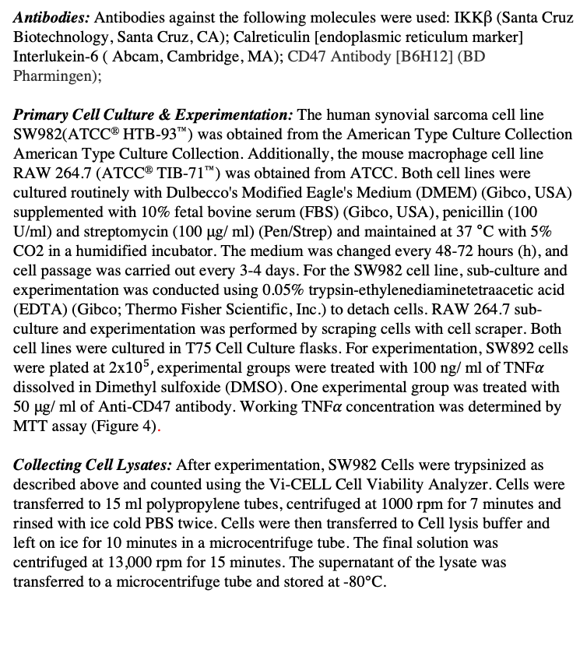
(Extra) In-Depth Materials and Methods
Antibodies: Antibodies against the following molecules were used: IKKβ (Santa Cruz Biotechnology, Santa Cruz, CA); Calreticulin [endoplasmic reticulum marker] Interlukein-6 ( Abcam, Cambridge, MA); CD47 Antibody [B6H12] (BD Pharmingen);
Primary Cell Culture & Experimentation: The human synovial sarcoma cell line SW982(ATCC® HTB-93™) was obtained from the American Type Culture Collection American Type Culture Collection. Additionally, the mouse macrophage cell line RAW 264.7 (ATCC® TIB-71™) was obtained from ATCC. Both cell lines were cultured routinely with Dulbecco's Modified Eagle's Medium (DMEM) (Gibco, USA) supplemented with 10% fetal bovine serum (FBS) (Gibco, USA), penicillin (100 U/ml) and streptomycin (100 μg/ ml) (Pen/Strep) and maintained at 37 °C with 5% CO2 in a humidified incubator. The medium was changed every 48-72 hours (h), and cell passage was carried out every 3-4 days. For the SW982 cell line, sub-culture and experimentation was conducted using 0.05% trypsin-ethylenediaminetetraacetic acid (EDTA) (Gibco; Thermo Fisher Scientific, Inc.) to detach cells. RAW 264.7 sub-culture and experimentation was performed by scraping cells with cell scraper. Both cell lines were cultured in T75 Cell Culture flasks. For experimentation, SW892 cells were plated at 2x${10}^{5},$experimental groups were treated with 100 ng/ ml of TNF𝛼 dissolved in Dimethyl sulfoxide (DMSO). One experimental group was treated with 50 μg/ ml of Anti-CD47 antibody. Working TNF𝛼 concentration was determined by MTT assay (Figure 4).
Collecting Cell Lysates: After experimentation, SW982 Cells were trypsinized as described above and counted using the Vi-CELL Cell Viability Analyzer. Cells were transferred to 15 ml polypropylene tubes, centrifuged at 1000 rpm for 7 minutes and rinsed with ice cold PBS twice. Cells were then transferred to Cell lysis buffer and left on ice for 10 minutes in a microcentrifuge tube. The final solution was centrifuged at 13,000 rpm for 15 minutes. The supernatant of the lysate was transferred to a microcentrifuge tube and stored at -80℃.
Indirect Enzyme Linked Immunosorbent Assay (ELISA)To measure protein expression/secretion, ELISA Assays were used to detect levels of CD47, Calrexticulin, MMP9, IKKB, Alpha-V Beta-3, and Interleukin-6. Assays were preformed using previously described antibodies at varying concentrations. Collected supernatants/lysates described above were played at 100 μl per well and allowed to adhere to an ELISA plate for 18 hours at 4℃. Following manufacturers protocol, wells were washed with Blocking buffer various times and placed in Primary Antibody solution, Secondary Antibody solution, and Substrate solution over the course of 4 hours. The plate was read with a microplate reader at 405 nm once it began to develop color. All experiments were conducted in at least triplicate.
Direct Co-Culture: To best model Rheumatoid Arthritis and the Synovium, SW982 Synoviocytes were directly co-cultured with Raw264.7 Macrophages. SW982 cells were detached with 0.05% Trypsin as described above, plated in a 96-well plate at 2x10^5 cells per well, and allowed to adhere for 24 hours. Cells were stimulated with indicated concentrations of TNF𝛼 for 24 hours. After 24 hours, the TNF𝛼 + Anti-CD47 wells were treated with the Anti-CD47 Antibody at 50ug/ml for 1 hour. After antibody incubation, all wells were rinsed 3x with 100 μl of Sterile-Phosphate Buffer Solution (PBS) to remove dead cells. This process also ensured TNF𝛼 would not affect the Raw264.7 macrophages, only the Synoviocytes. Next, SW982 cells were placed in serum-free DMEM + Pen/Strep. Before Raw264.7 Macrophages were added to the 96-well plate, cells were detached from cell-culture flasks by scraping and pelleted at 400g for 7 minutes. The Pellet was rinsed with serum-free DMEM + Pen/Strep in order to starve macrophages. Macrophages were starved for two hours before coculture. Macrophages were added to coculture at a density of 1x10^5 cells per well. Synoviocytes and macrophages were incubated in coculture for 3 hours. After 3 hours, the semi-adherent Macrophages were transferred from the coculture 96-well plate to a separate 96-well plate. An MTT Assay was run on cocultured macrophages as described below.

Slide 15
MTT Assay: Cell growth inhibition was evaluated with Cell Titer 96® Aqueous Non-Radioactive Cell Proliferation Assay kit (Promega, Madison, Wi, USA) according to manufacturers' instructions. In MTT Assay 1, Figure 4, SW982 Cells were seeded in 96-well plates at a density of 2x10^5. After allowing cells to adhere for 24 hours, cells were treated with the indicated concentration of TNF𝛼. Then, 20 μl of the combined MTS/PMS solution was pipetted into each well. After incubating for 2 hours, the absorbance of plate was measured at 490 nm using a Microplate plate reader to determine proliferation.
Phagocytic Assay: In order to determine the effect treatments had on phagocytosis rates, a phagocytic assay was performed. This was done by using co-culture methods previously described on stained cells. Stained Red SW982 cells were plated, allowed to adhere to and treated in 96-well plates. After 24 hours, the designated row of treated wells was incubated with the Anti-CD47 antibody. Then, the cells were intensely washed with PBS. Raw264.7 Macrophages that had been starved for two hours as described above were then added to the coculture. The coculture was incubated for 3 hours at 37 °C with 5% CO2 in a humidified incubator. Immediately, semi-adherent macrophages were removed and imaged using an inverted-fluorescent confocal microscope. To quantify this data, cells were prepared according to manufactures instructions and read by the Beckman Coulter Cell Lab Quanta fluorescent spectrophotometer.
Fluorescence Staining: SW982 cells were stained with PKH26 using PKH26 Red Fluorescent Cell Linker Kits for General Cell Membrane Labeling (Sigma-Aldrich). Briefly, cells were detached from the cultured dish with the use of Trypsin EDTA solution (Sigma USA) and pelleted. In order to prevent serum from affecting dye, cells were rinsed in serum-free DMEM containing only penicillin (100 U/ml) and streptomycin (100 μg/ ml). Cell count was done via trypan blue (Gibco USA) exclusion using the Vi-CELL Cell Viability Analyze to determine the total number of cells and viability before staining. The concentration given for general cell staining procedures is 4 × 10−3 mol/ml per 20 million cells. Cells were stained with 4x10^(-3) mol of PKH26 dye in 15 ml polypropylene tubes using the Diluent C fluid supplied with the kit. The cell count was done before culturing back in a T-75 cm flask, with Dulbecco's Modified Eagles Medium (DMEM) + 10% fetal bovine serum medium(Gibco USA). Additionally, the Raw264.7 macrophage cell line was stained withPKH67 Green Fluorescent Cell Linker Kit for General Cell Membrane Labeling as described above (Figure (x)). Cells were monitored with light microscopy, live imaging fluorescence microscopy, and confocal microscopy.

